Slide 1
Spring-Mass Damper ContROL Schemes
Rizve Chowdhury
Astranis GN&C Candidate

Slide 2

Hello!
Hi!
Before we deep dive into this fun little project, a few things about me:
I graduated with a Bachelors in Aerospace Engineering from the University at Buffalo.
Straight out of college, I was able to dive deep head first into GM’s high volume production BEV programs, learning lessons on how to manage expectations and thinking calmly in times of panic.
I love learning and solving problems of any and all kinds.
Look forward to getting to know everyone!

Slide 3
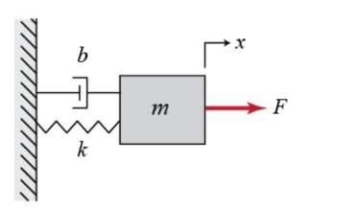
System DESCRIPTION
Within the system boundary, there are five distinct elements that interact with one another:
Spring
Damper
Mass
Controller
Support (assumed rigid)
Damper
Critical assumption to system behavior are made. These are:
Spring obeys Hooke’s Law
Damper behaves linearly and produces a force that is directly proportional to speed of extension/compression
Line of action of spring and damper are coincident when acting on mass (no moments on mass)
Gravity is neglected
Support is static
System parameters are known to +/- 20% of their true value
Support
Force Output (from controller)
Spring
Mass

Slide 4
Problem DEFINITION
Customer Requirement:
Build a closed-loop simulation of the system. Controller must be robust
Engineering Requirement(s):
1) Controller must be able to track a static set-point in position.
2) Controller must be able to negate environmental disturbances
3) Simulation must be able to model sensor physics (i.e. delays and offsets)
4) Simulation must be able to model actuator physics (i.e. saturation)
5) Simulation must be able to study variation in system parameters (sensitivity)
6) Simulation must report out on energy and force statistics versus time

Slide 5
CODE STRUCTURE
Parameters
Main Loop
Code was separated into modules based
on whether they required to maintain a state.
If the particular aspect of the code required a
“memory” then it was separated into a distinct
module and made into a class.
Controller
Dynamics
Sensor

Slide 6
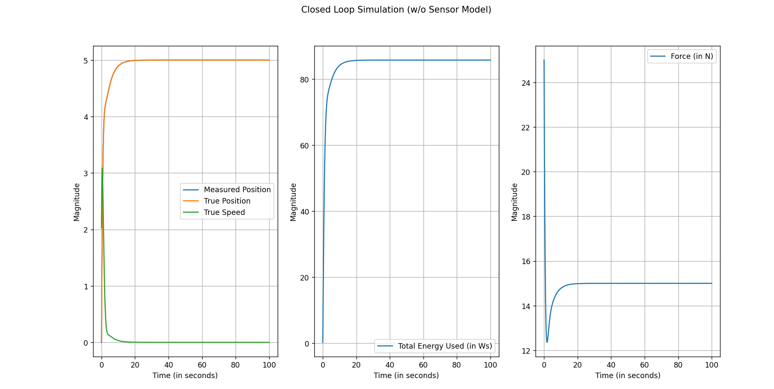
IDEAL CLOSED LOOP SIMULATION

Slide 7
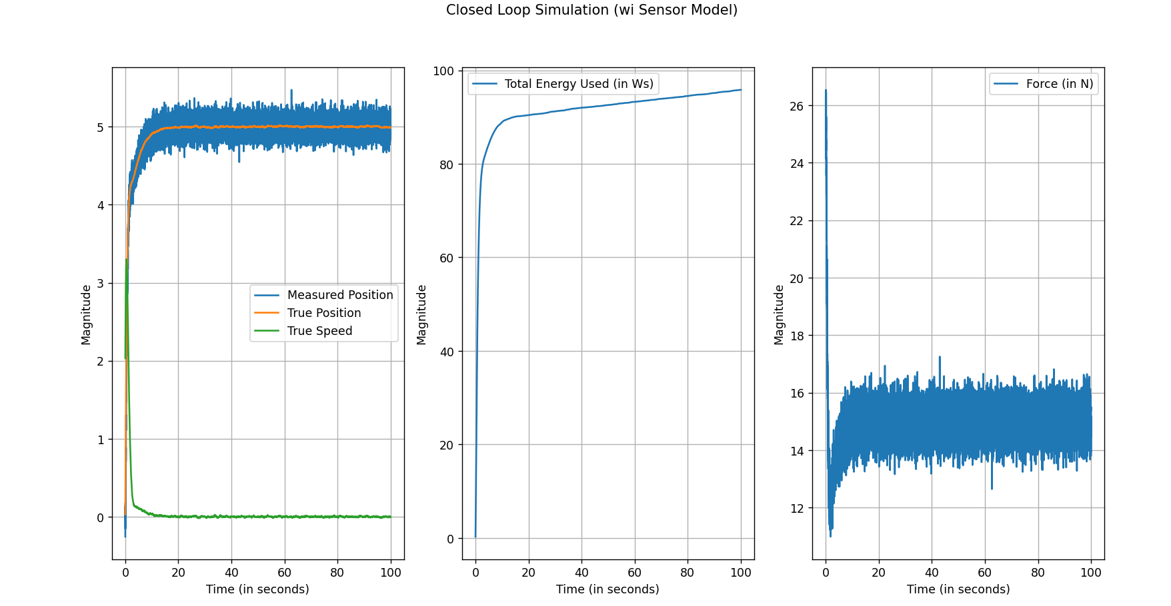
Closed Loop SIMULATION (Noisy SENSOR)

Slide 8
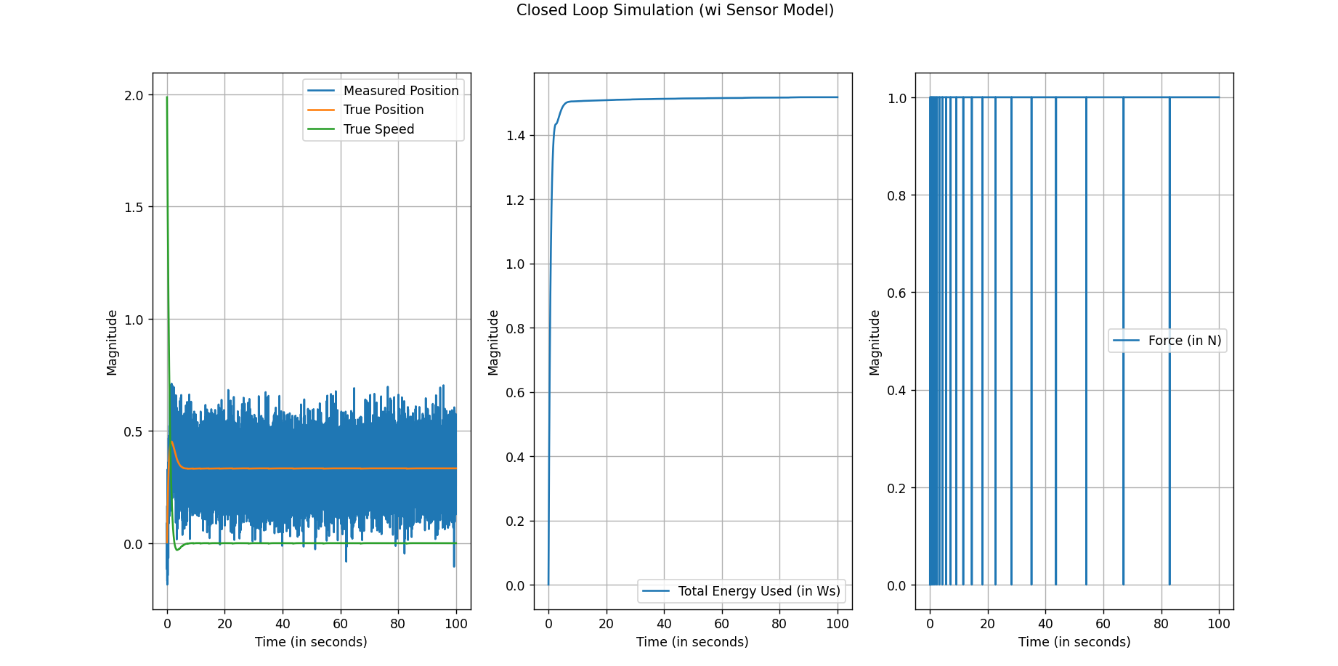
Closed Loop SIMULATION (Noisy SENSOR & Actuator)

Slide 9
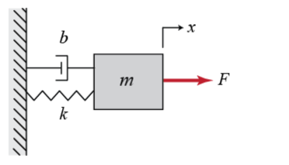
PRELIMINARY CONCLUSIONS
PI control proved to be robust with the sensor physics integrated. Sole control using a proportional scheme does not allow for set-point tracking. Integral control was implemented using a simple numerical quadrature scheme
Simulating the saturated actuator showed that this actuator cannot support tracking any set-point above 1 m. This can be proved by drawing a FBD on the mass. When all the kinetic energy is exhausted by the damper, it can be seen that a steady-state force of F > kX_set is required to push the mass towards X_set, the position set point. At 1 N, we can only track X_set < 0.33
0 N
kX

Slide 10
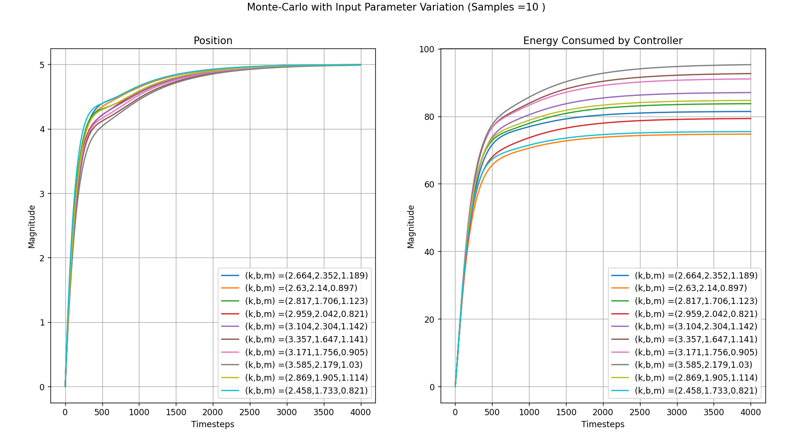
Monte-CARLO Analysis
SYSTEM SIMULATION
10
Behavior of settling time is relatively insensitive to changes in system parameter. However, energy consumption seeing changes of 30% due to +/- 20% change in input parameters

Slide 11
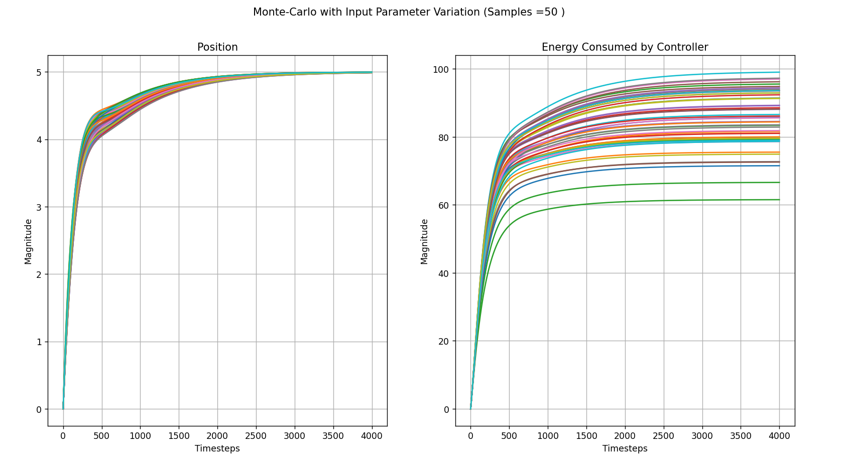
Monte-CARLO Analysis
SYSTEM SIMULATION
11

Slide 12
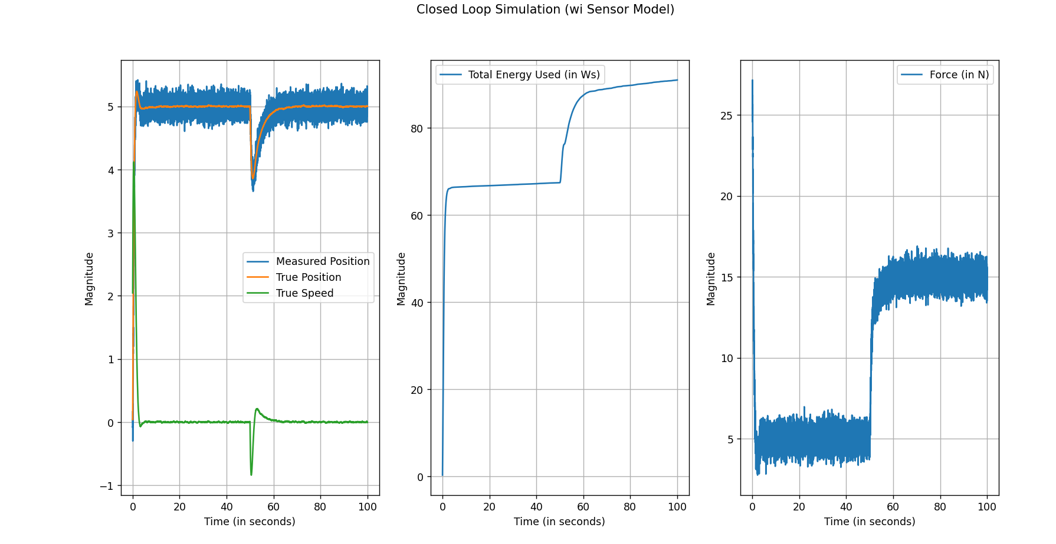
Disturbance Rejection
SYSTEM SIMULATION
12

Slide 13
SENSITIVITY STUDY CONCLUSIONS
Control policies based on minimizing energy or time is not viable under uncertainty of system parameters.
Optimal control designed for nominal parameters will not function well under variations of system parameters.
C) Settling time and other transient measures seem to be robust under variation of system parameters.

Slide 14
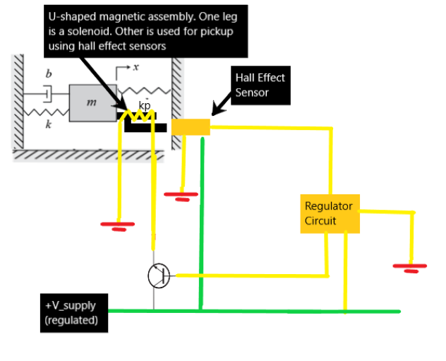
PI Control IMPLEMENTATION
The size of the system (i.e. system has to fit within an envelope) will dictate how PI is implemented. However, if low latency and high fidelity control is required, it can be achieved with a solenoids and a regulator circuit (without the need for a microcontroller). This frees up computing resources to focus on fault detection and recovery.

Slide 15
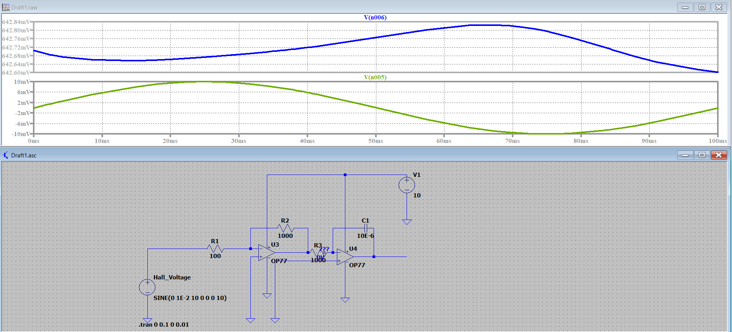
Regulator Circuit

Slide 16
Thank you FOR YOUR TIME & PATIENCE

